Slide 1

Welcome to THE VFW DEPT of Indiana
Post quartermaster Training
Tuesday, August 11, 2026
Meeting Will Start at 6:00 PM ET – This is Automated Slide (no host)
MUSIC is playing in the background. The Meeting Will Start in approximately:
4 MINUTES
Notes:
Prep for meeting:
Start Timer (countdown to meeting start)
Start Slacker music and Zoom
Start PPT (check dates in intro slides)
Share screen (ensure AUDIO also shared)
Activate PPT Laser pointer
Have Materials ready to load into chat: State Site & OMS instructions, group 501c19 packet for posts

Slide 2

Welcome to THE VFW DEPT of Indiana
Post quartermaster Training
Tuesday, August 11, 2026
NO Participants at Start Time– Waiting for People to Show
(until meeting time +15 minutes)
MUSIC is playing in the background. Waiting for People to Show will End in approximately:
4 MINUTES

Slide 3
VFW Department of Indiana
SCHOOL OF INSTRUCTION
PARLIAMENTARY Training
SATURDAY, August 29, 2026
Welcome to Today’s Meeting!

Slide 4

Meeting topics and agenda
introduction
Government Reporting
VFW Reports
Insurance
Bonding
Recurring Post QM Items
Question and Answer Time

Slide 5
Disclaimers and caveats
I’m Not a lawyer and I’m Not a CPA
References and links to resources are provided as much as possible
Customs and Will of Membership versus Bylaws, Laws, & Regulations
  “No” is right answer; often we can find another way to “Yes”
you may need to consult a Professional for some Questions and specific Situations
Many situations vary case-by-case

Slide 6
introduction
Welcome & Thank You!
Team of Volunteers
Your Post, Your Membership, Your INC.
Each Post & Situation is Unique –
Many situations vary case-by-case
“We’ve always done it that way” – out of date?
Overview – Basic Information

Slide 7
PARLIAMENTARY RULES – WHAT ARE THEY?
A Rulebook for Fair Meetings
VFW Uses Roberts Rules of Order (12th Edition)
First Published in 1876 by U.S. Army officer Henry Robert
a common, tested set of steps for proposing ideas, debating them, and deciding as a group
most widely used meeting-procedure guide in the English-speaking world

Slide 8
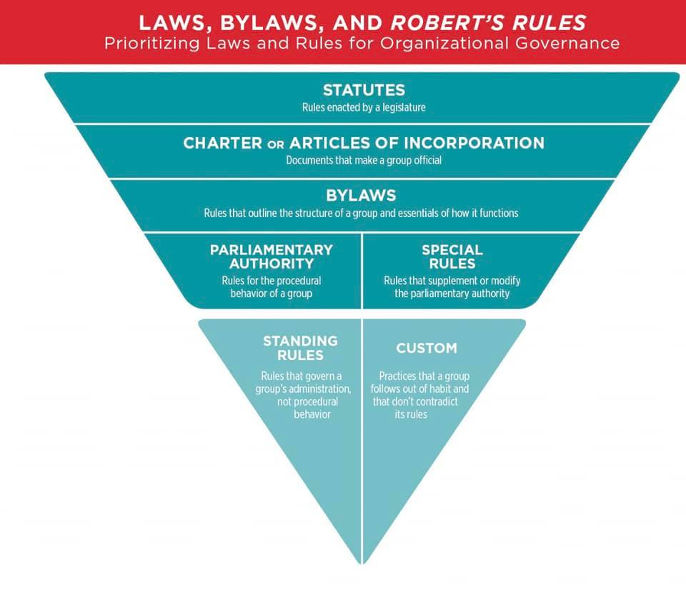
PARLIAMENTARY RULES – where do they fit in?

Slide 9

VFW National bylaws

Slide 10
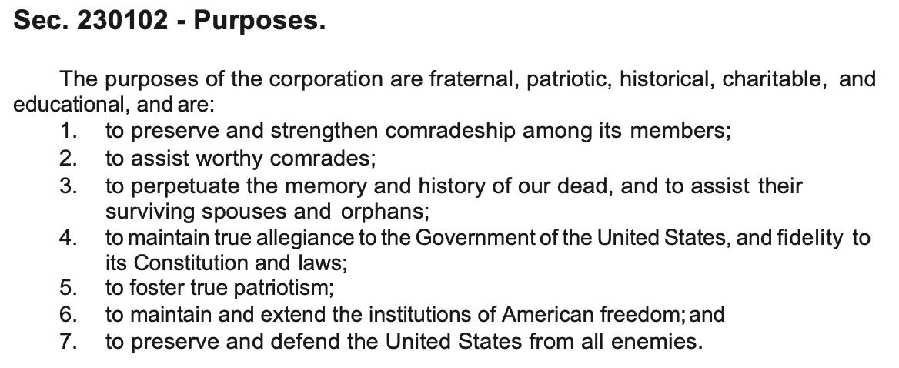
PURPOSES of the vfw
Fraternal Organization
Take care of each other
… veterans
…. our communities

Slide 11
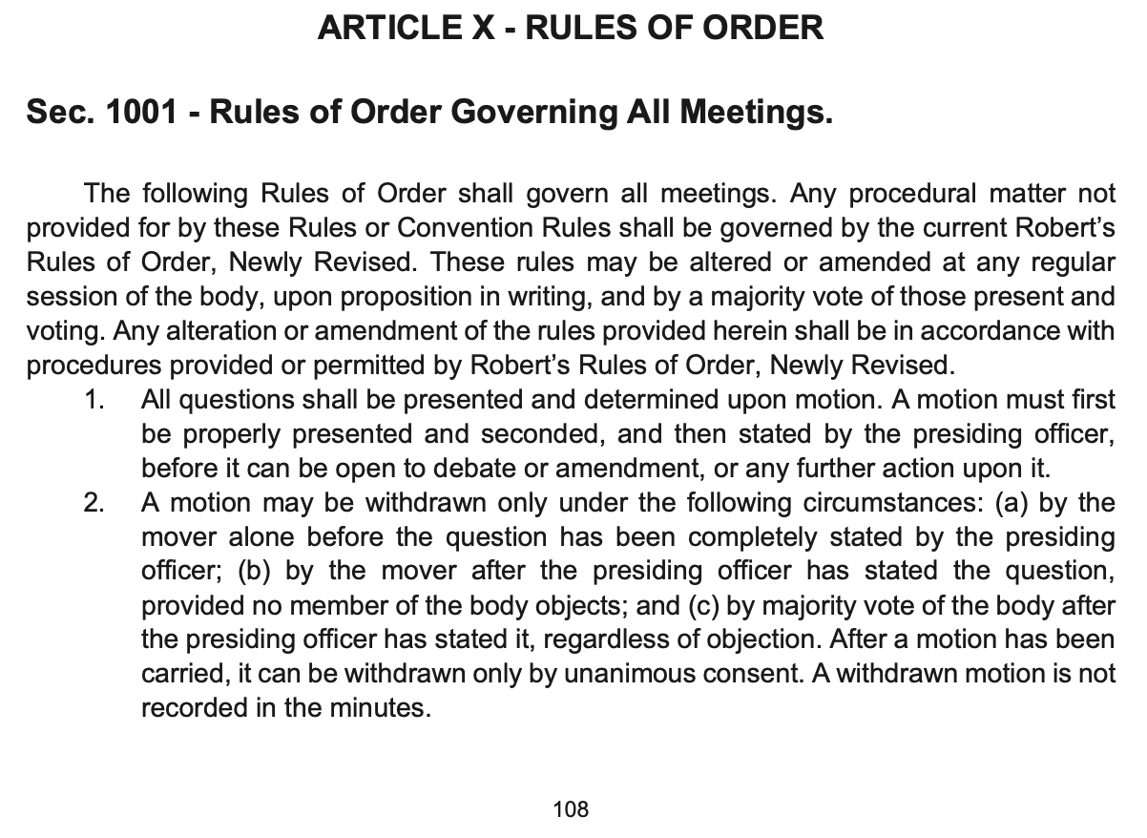
VFW National bylaws
Under training on VFW.IN (log in)
MOP Section 1001 (Standing Rules)

Slide 12
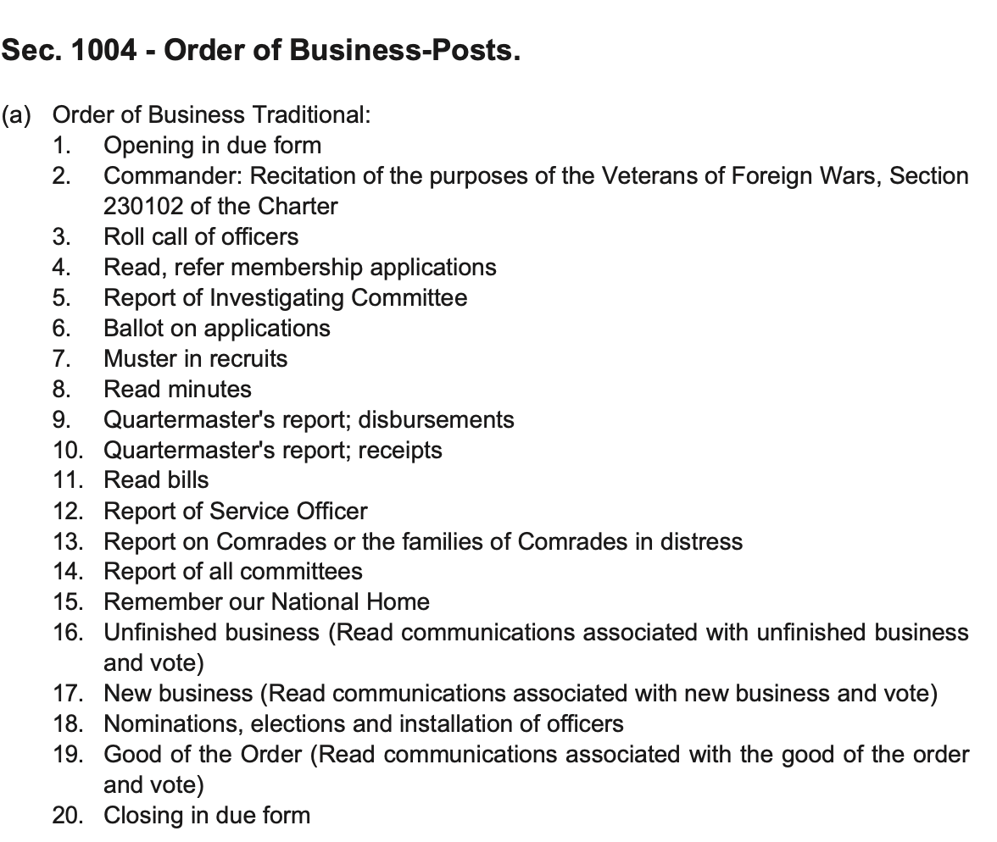
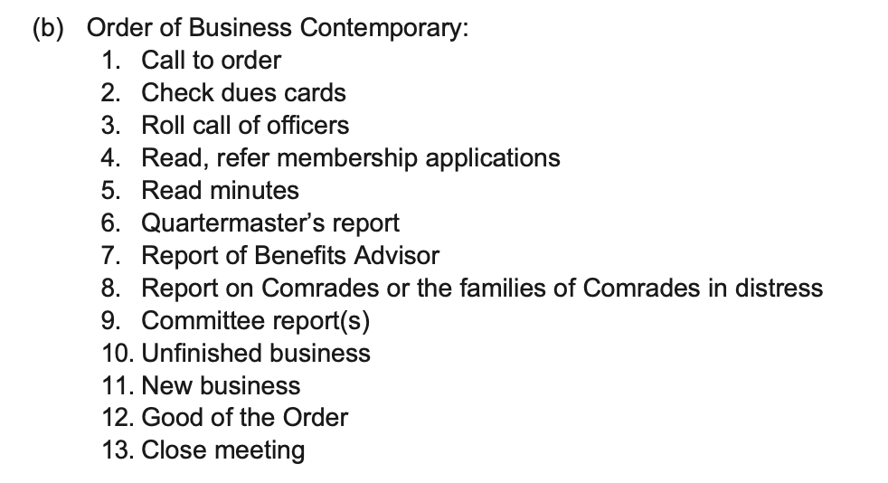
VFW National bylaws
MOP Section 1004 (Post Order of Business)

Slide 13
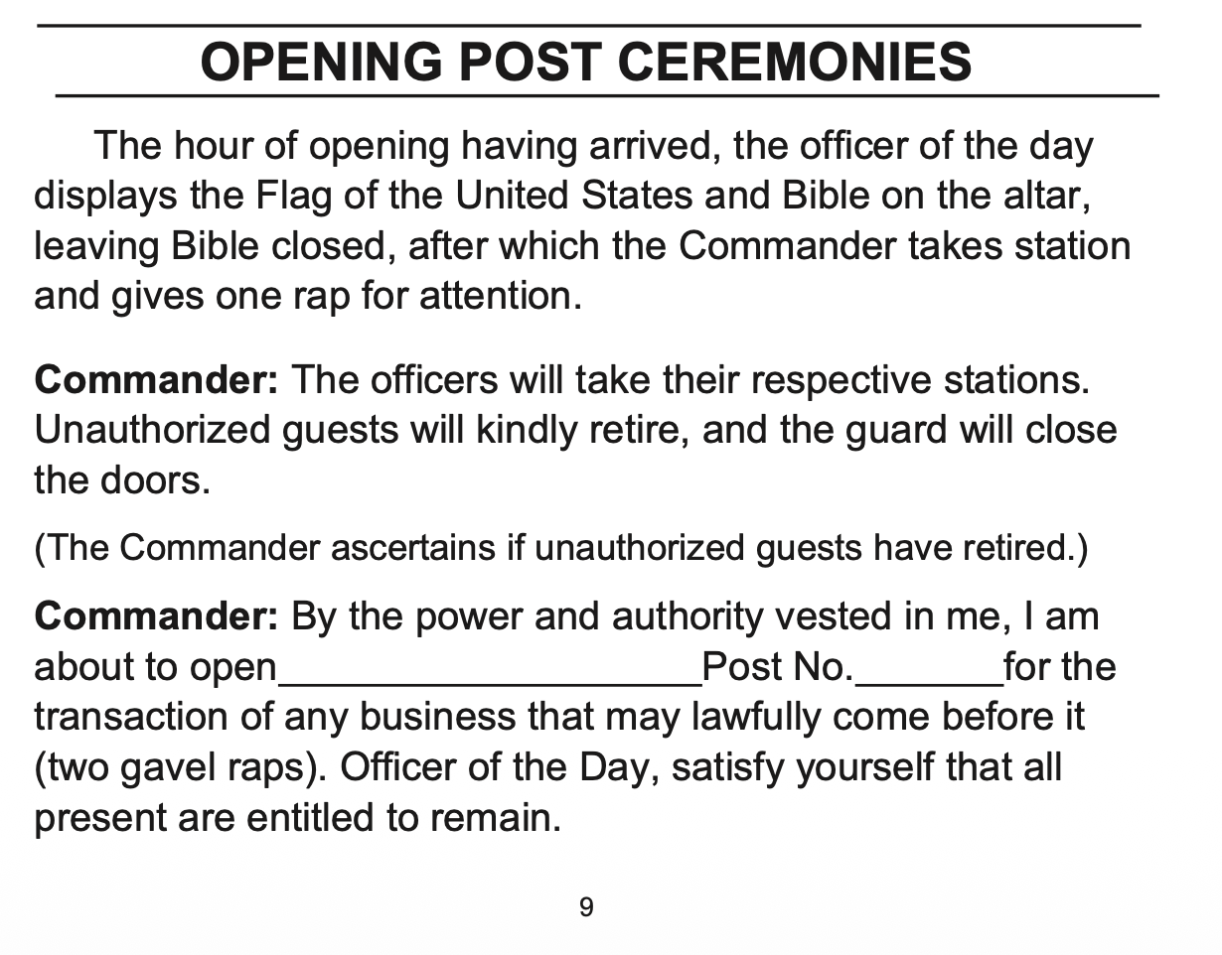
VFW National bylaws
RITUAL Section p. 9 (Opening Post Ceremonies)

Slide 14




WHY IT MATTERS –
Why Groups Rely on These Rules
Fairness
Efficiency
Majority Rule
Clear Record
Every member gets a chance to be heard, and no single voice can dominate the floor.
One item is handled at a time, so meetings move forward instead of circling back.
Decisions reflect the will of the group while still protecting the minority's voice.
Motions and votes are documented, so decisions are official and easy to revisit.

Slide 15
THE FOUNDATION –
FOUR CORE PRINCIPLES
One Thing at a Time
Courtesy & Order
Equal Speaking
Minority is Heard
Only one motion is on the floor at once, so debate stays focused and doesn't fragment.
Members speak through the chair, and personal attacks or interruptions are out of order.
No member may speak twice on a motion until everyone who wants to has spoken once.
Majority decides, but minority viewpoints must be allowed full and fair debate first.

Slide 16

WHO’s WHO –
KEY ROLES IN THE ROOM
The Chair
The Secretary
The Members
Presides over the meeting, recognizes speakers, keeps discussion on the pending motion, and stays neutral in debate.
Records the minutes, tracks motions and their outcomes, and keeps the official written record of the meeting.
Make and second motions, debate the issues, and vote — the group's actual decision-making power.

Slide 17
The Chair’s Role
Call the meeting to order and establish the presence of a quorum.
Recognize members before they speak.
State motions clearly so everyone knows what is being considered.
Maintain order and enforce the adopted rules.
Remain impartial while presiding.
Announce the result of each vote and move the meeting to the next item.

Slide 18
The MEMBERS’ Role
Wait to be recognized by the chair before speaking.
Keep remarks relevant to the pending question.
Address comments through the chair.
Follow time limits and other adopted meeting rules.
Use motions to bring business before the assembly.
Respect the result of a vote.

Slide 19
Before business can be conducted – Quorum must be established
A quorum is the minimum number of members who must be present to conduct business.
The organization's bylaws normally establish the quorum requirement.
The chair should determine whether a quorum is present before substantive business begins.
If there is no quorum, the assembly generally cannot conduct ordinary business.
Always check your bylaws

Slide 20
HOW TO MAKE SOMETHING HAPPEN –
LIFE CYCLE of a Motion
1
2
3
4
5
Member Moves
Motion Seconded
Chair States It
Members Debate
Group Votes
A member is recognized by the chair and says, "I move that..."
Another member seconds it, showing more than one person wants it discussed.
The chair restates the motion so everyone is debating the same wording.
Members speak for and against, alternating sides where possible.
The chair calls the vote and announces whether the motion passes or fails.

Slide 21
Making a motion (main motion)
A main motion is a proposal that the assembly take a particular action.
Example: “I move that the Post purchase a new computer for the Quartermaster's office.”
A main motion requires a second before debate can begin.
The chair states the motion, then members debate and the assembly votes (Make sure it’s clearly stated)
Once stated by the chair, the motion belongs to the assembly—not to the maker of the motion

Slide 22
processing a motion – common subsidiary motions
Amend — changes the wording or details of the pending motion.
Refer — sends the matter to a committee or another group for further consideration.
Postpone — delays consideration until a specified time or circumstance (Definite vs. Indefinitely)
Limit or Extend Debate — changes the amount of debate permitted.
Previous Question — ends debate and moves to voting when the required threshold is met.
Lay on the Table — temporarily sets aside a pending
matter for an urgent or immediate purpose.

Slide 23
processing a motion – amendments
An amendment changes the pending motion; it does not replace it with an unrelated proposal.
Common forms: insert, add, strike out, or strike out and insert.
Example: Main motion — “Approve $5,000 for landscaping.”
Amendment — “Change $5,000 to $3,500.”
Debate on an amendment is limited to the amendment itself.
After the amendment is decided, we return to the
main motion as amended—or unchanged.

Slide 24
processing a motion –
Debate: Keep it Productive
Debate the issue, not the person.
Stay relevant to the motion currently before the assembly.
Give members a reasonable opportunity to speak.
Avoid repeating points that have already been made.
The chair can enforce decorum and time limits under the organization's rules.
Healthy debate is part of good governance—not a sign that a meeting is failing.

Slide 25



DECIDING TOGETHER –
HOW VOTING WORKS
Voice Vote
Show of Hands
Roll Call
Ballot Vote
The default method — members call out "aye" or "no" together.
Used when a voice vote is too close to call, or for a visual count.
Votes recorded by name — common for high-stakes decisions.
A written, secret vote, typically required for elections.
Most motions need a simple majority — more than half the votes cast — to pass.
Higher Thresholds
Some actions require a two-thirds vote — amending bylaws, closing debate, or suspending a rule — because they limit members' rights.

Slide 26
Common mistakes to avoid
Letting discussion begin before the chair has stated the motion.
Allowing several motions to be debated simultaneously.
Confusing a motion's maker with ownership of the motion.

Slide 27
Common mistakes to avoid (con’t)
Calling for a vote before members understand the exact question.
Treating Robert's Rules as more important than the organization's bylaws.
Using procedure to shut down legitimate member participation.

Slide 28
Key takeaways
“BE FAIR, BE RESPECTFUL, BE EFFICIENT”
Know your bylaws first.
Use Robert's Rules as a tool for orderly decision-making – IT’S an AID to HELP, NOT A WEAPON
Make motions clear, specific, and actionable.

Slide 29
Key takeaways (con’t)
Let the chair manage the process and members debate the substance.
Record decisions accurately in the minutes.
Good parliamentary procedure should make meetings more effective—not more complicated.

Slide 30
Question and Answer Time
Watch for Future Training
Q&A (time Permitting)
Follow up after meeting
Monthly QM Training
One-off training / more specific training / Questions available
Invite me to your district meeting or
district school of instruction

Slide 31
Meeting Close Out / Conclusion
Thank you for Attending!
Additional Questions (small group)
Comments or Suggestions?
(QM@VFWIN.ORG)

